Slide 1
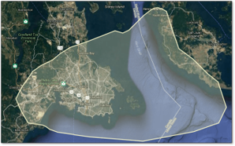

All Hazards Application of RCM in BC part 2
Ash Richardson
Band 3 Senior Data Scientist
BC Wildfire Service (FLNRO) and Digital Platforms and Data Division (CITZ)
Canadian Space Agency (CSA) Radarsat Constellation Mission (RCM) Users' Forum (May 18th, 2022)

Slide 2
Overview
Purpose
Here to build relationships w CSA and partners!
Team context
BC Wildfire does fire. Moving to all-hazards...
Multi-sector role: bridge geospatial vs admin (or other seemingly disparate) data
On loan from Citizens' Services (Chief informatics Office) AKA Integrated Data Division..
EL SME RS/AI/HPC
Multispectral / hyperspectral / Radar project context
Fire progression: Immediate operational emphasis
Reference data to support RCM fire monitoring analysis
Stepping-stone to continuous forest mapping (province wide NRT)
Synergy!
Partnerships, cooperation, collaboration (local to international)
Value in open, reusable, modular systems, data or processing?
Today: Image translation as a metaphor for collaboration

Slide 3
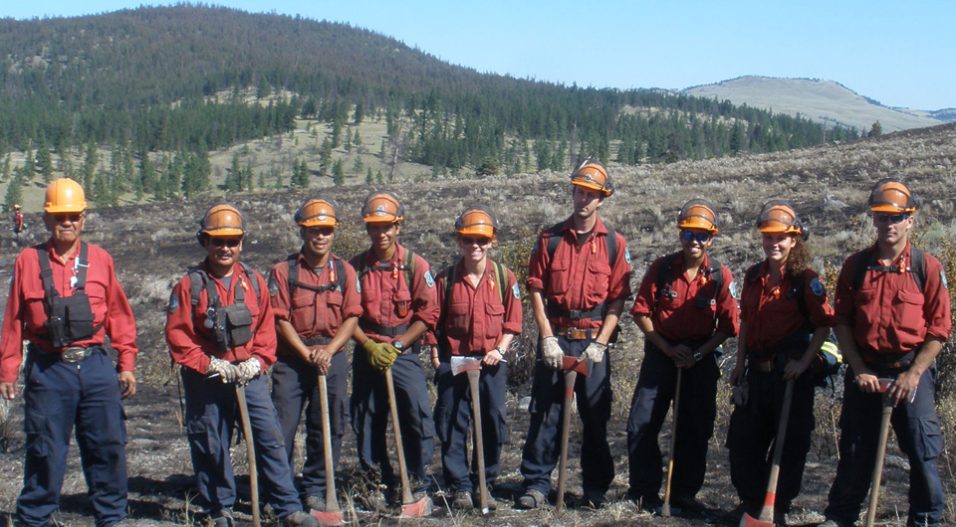
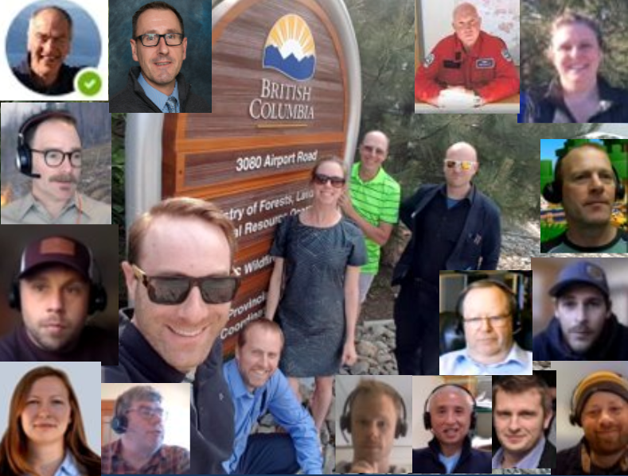
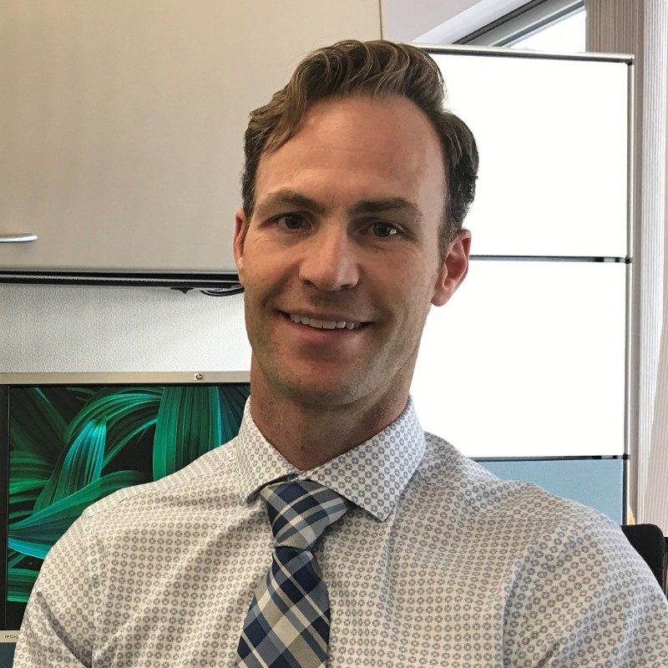
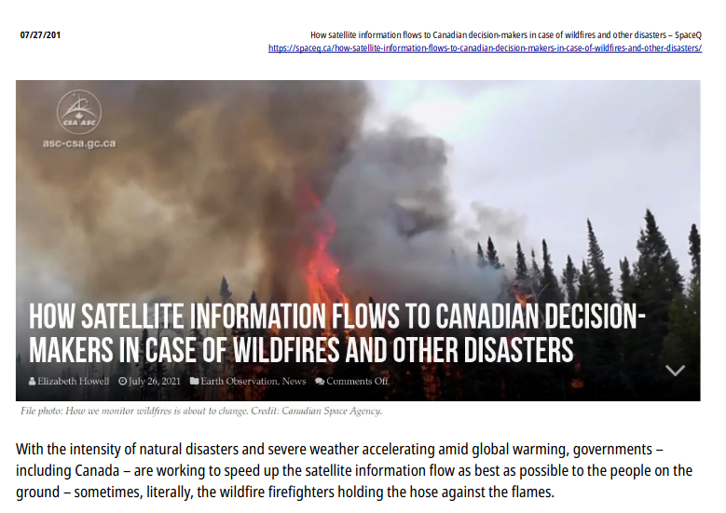
BCWS Predictive Services Unit
Report to Deputy Director, Wildfire Ops
Meteorology
Fire Behavior + Agile Software Engineering
Data Science: enhancing operational use of RS
Also promoting continuously-updating geo-intelligence. Reproducible transparent methods
Mandate:
Daily and increasingly-proactive situational awareness to support Prevention, Preparedness, Response, Recovery

Slide 4

Recent communications/ timeline
Fire mapping with Shortwave Infrared, BC Government Remote Sensing CoP, Apr 13 2022
Fire mapping with Sentinel-2, BCWS Geomatics CoP, Mar 16 2022
Longitudinal encounter histories as text: Using natural language processing and graph machine learning methods to locate patient voices within constituencies, Putting Patients First, March 10 2022
Remote Sensing and Pattern Recognition in BCWS Predictive Services Unit, BCWS Priorities Forum, Jan 6 2022
Field Observations and Remote Sensing of Wildland Fuels: A Case Study, Bulkley Valley Research Centre, Oct 8 2021 2021 (*)
All Hazards Application of RCM in BC, CSA RCM Users Group Meeting, Nov 25 2021
(*) non composite / use all acquisitions. 3d from 2d?

Slide 5
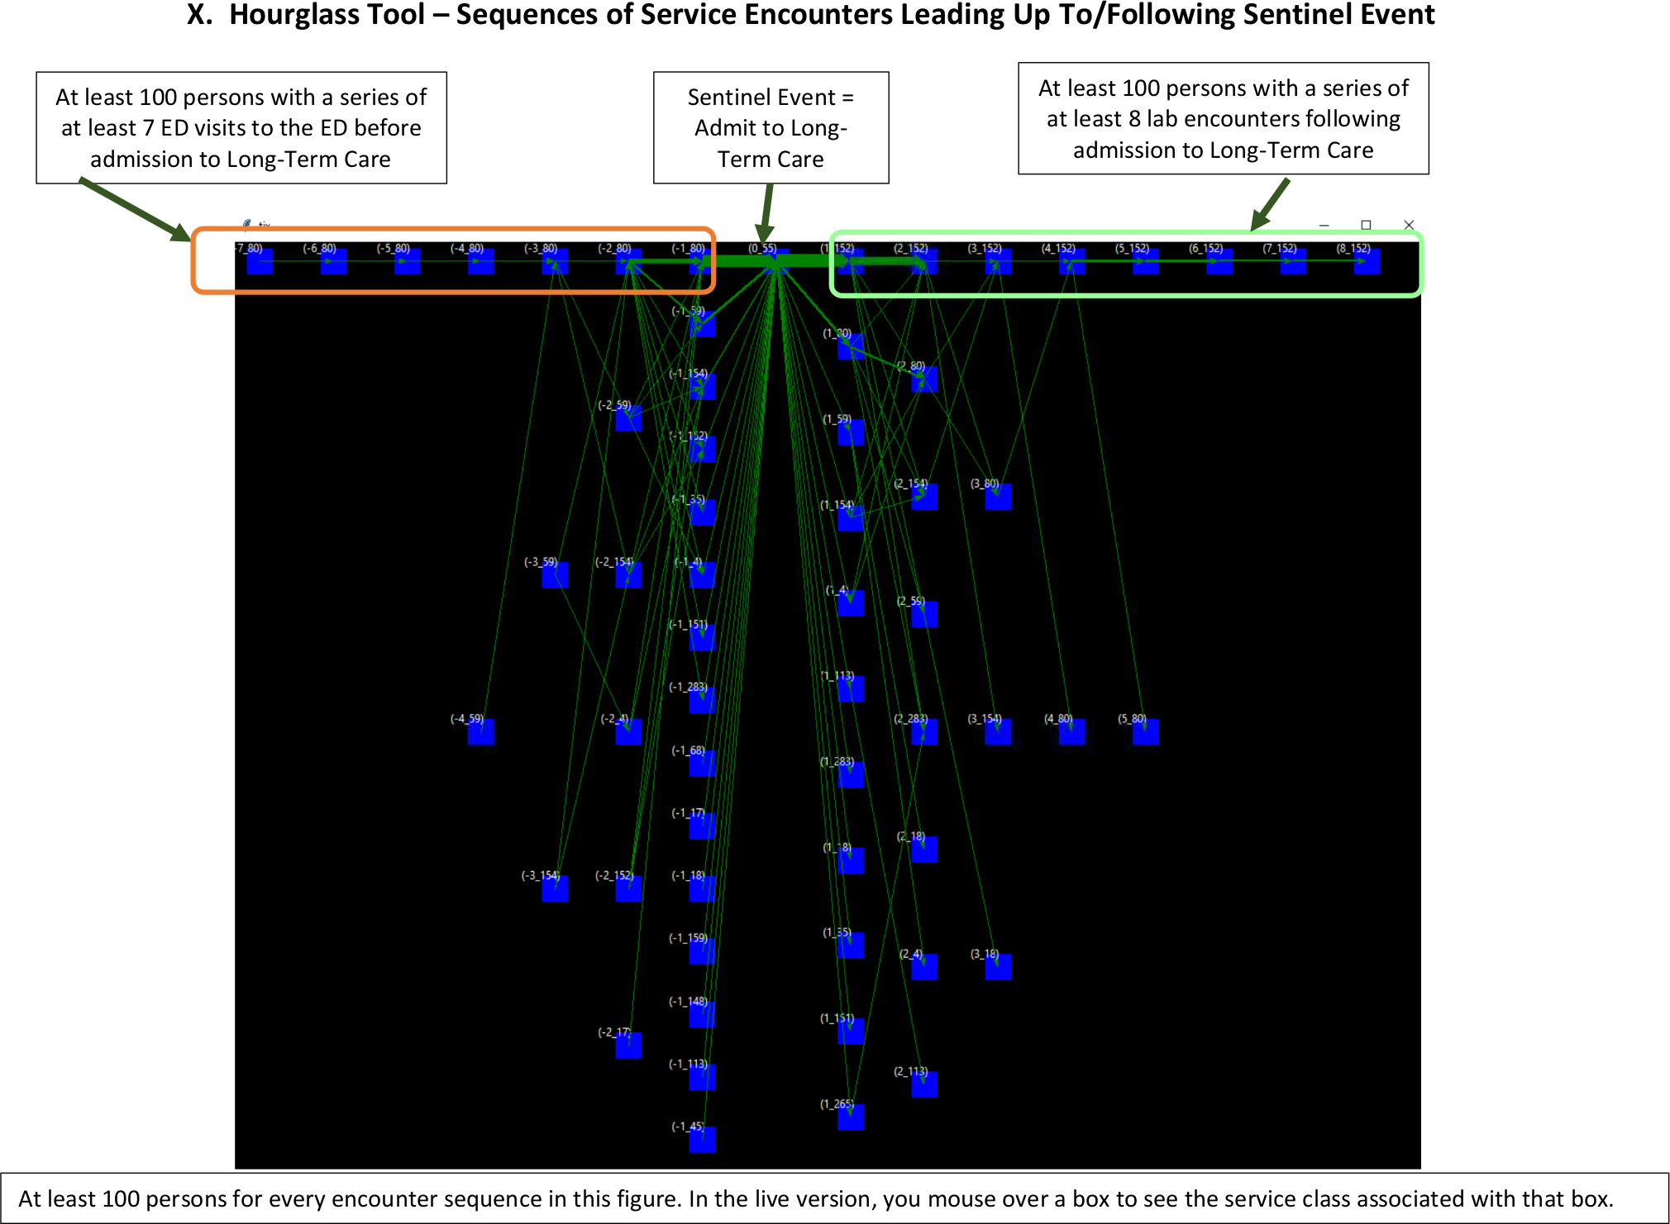
"Trajectory methods"
I.e. considering
relationships, & event sequentiality
Hourglass implementation:
inspired by the "light cone" of physics, to bring time and space into visualizations of x-actional data (Thanks Dr. Cloude)
Input: "tabular data"
Set "X" to any outcome of interest
Result:
past outcomes that converge towards X
Future outcomes that emanate from X
Event aggregation: not ML / NN based
Determinants and effects of: health conditions (or other phenomena)
Next: bring this back into geospatial to understand forest / eco succession.
A) D'où venons-nous ?
B) Que sommes-nous ?
C) Où allons-nous ?

Slide 6
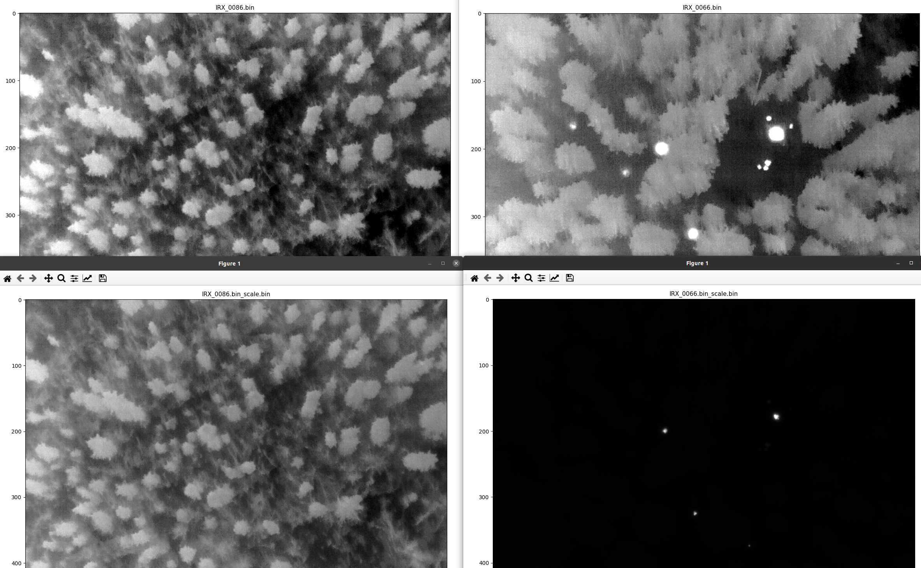
UAV
hotspot detection +
geolocation

Slide 7
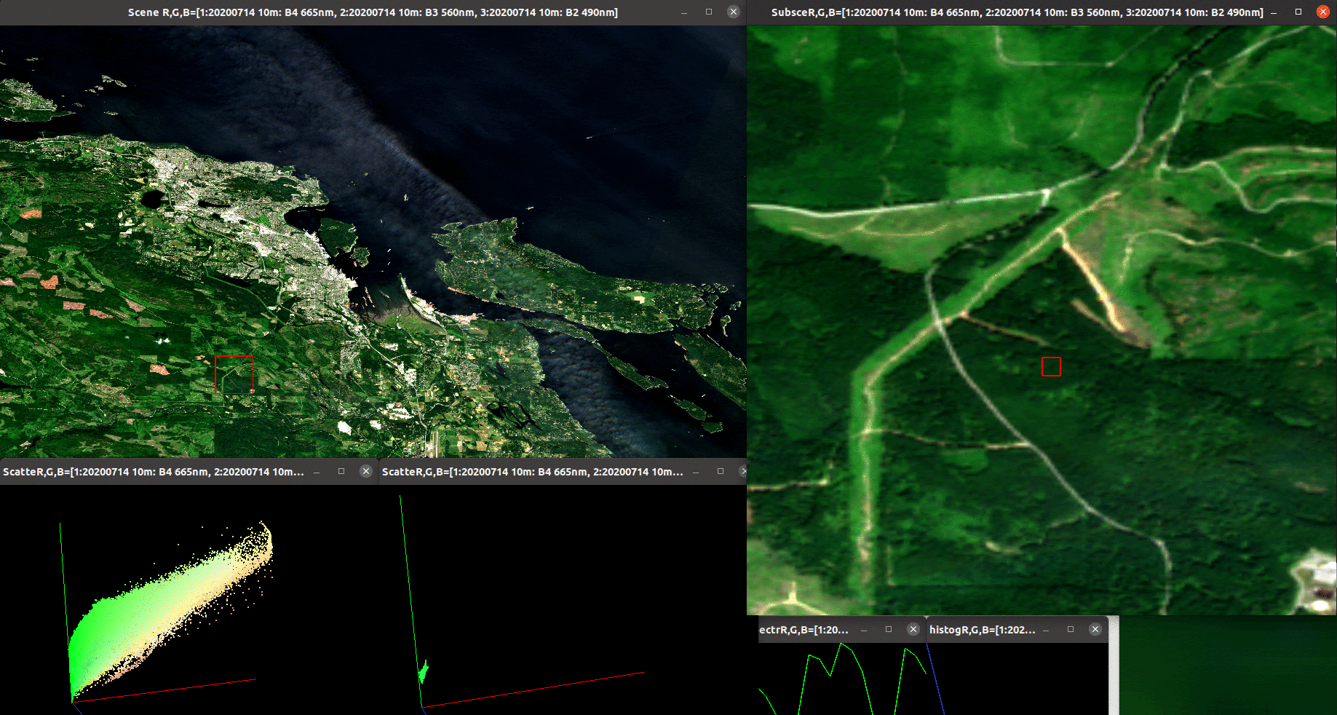
Interactive visualization accelerates understanding of PolSAR and multisource data
The story of: Logging

Slide 8
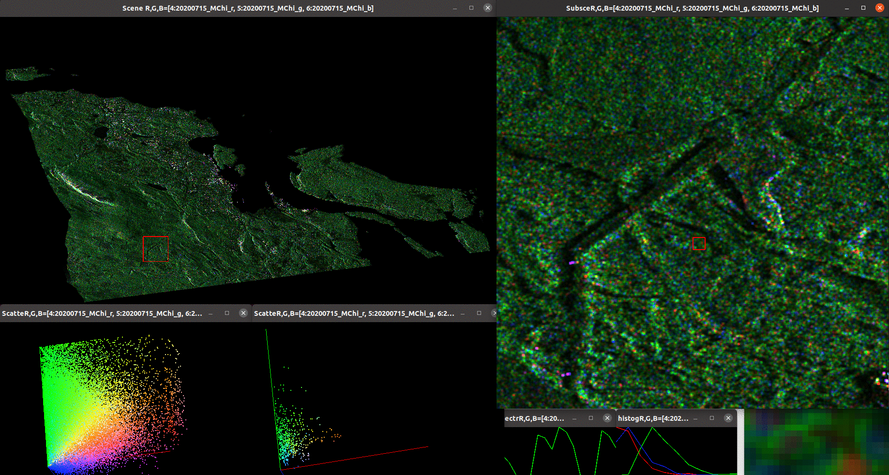
RCM response from the clearcut is less random after cutting
How to bridge different kinds of data?
"Simplify as much as possible but no more"

Slide 9
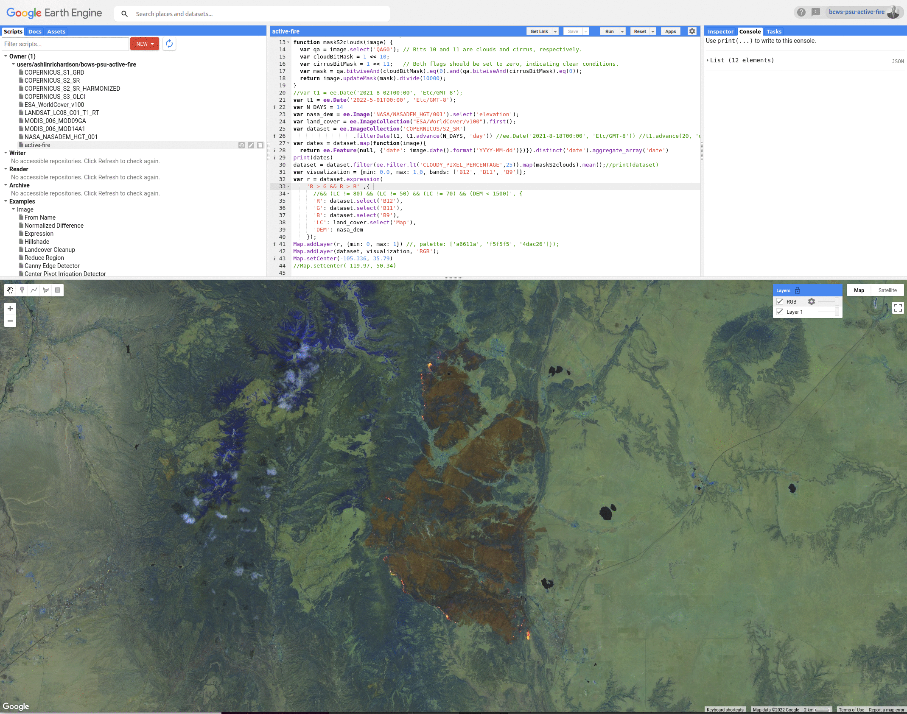
How to map fires in Sentinel2? B12 > B11
Need to mask out:
water
High elevations

Slide 10
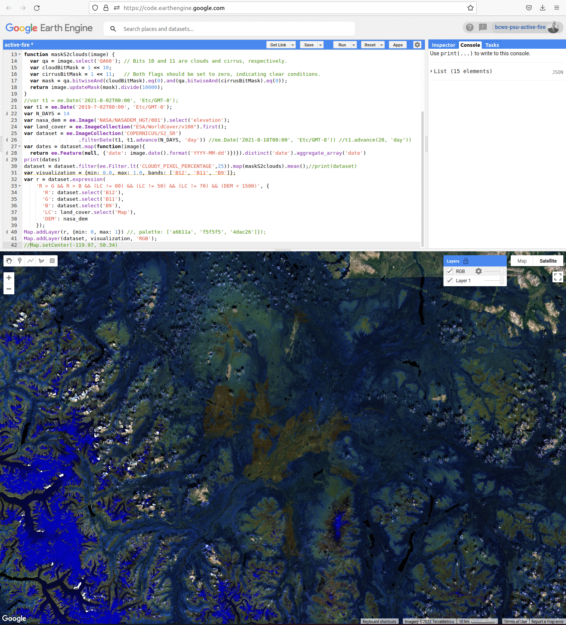
Telegraph Creek area fires (BC) 2019 Have a 3rd iteration of a field study underway in the area this year

Slide 11
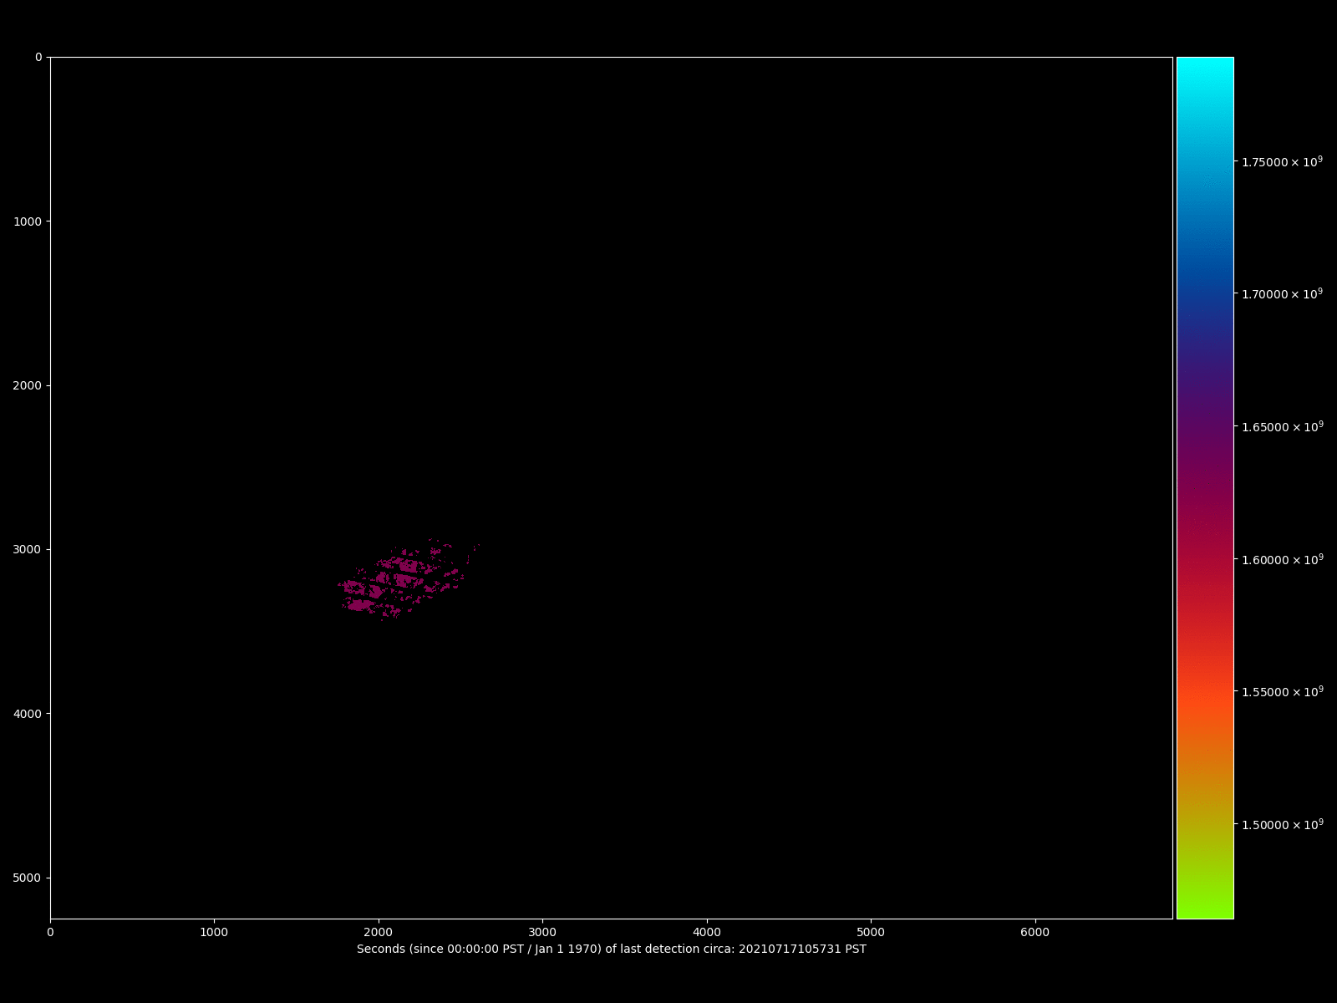
White Rock Lake Fire 2021 BC (12 updates, Landsat 7,8 and Sentinel2)
Simple
Classification
Rule generalizes
Across sensors
By "spectral
Interpolation"
Not perfect..
..Accessible!
Tested it on
Sentinel2
Landsat 7, 8
ASI Prisma

Slide 12
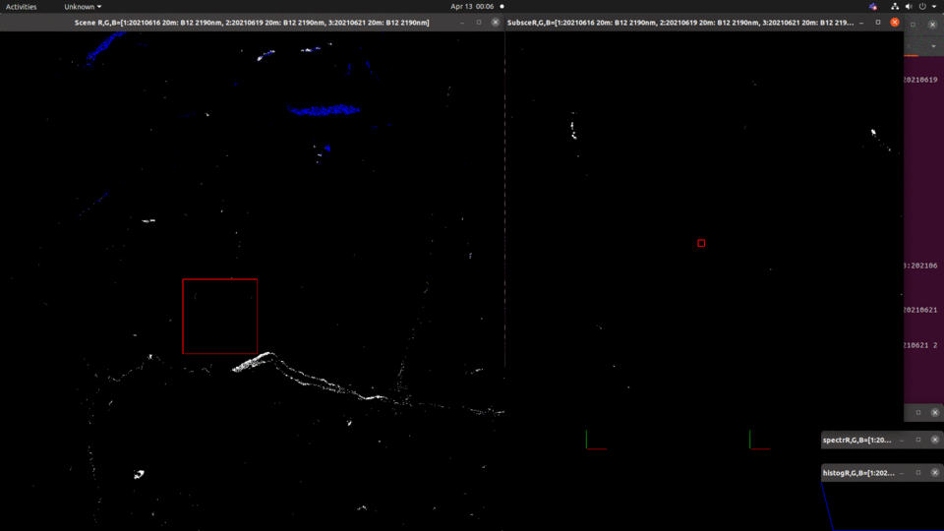
ABCD algorithm
Progression mapping: Sparks lake and Tremont creek fires (2021)
IN progress: overlay w RCM CP-pol time series.. (challenges: dealing w multiple acquisition angles.. ?)

Slide 13
New algorithm: ABCD method!
For A, B, C (input) images(*), an answer to the question:
A is to B, as C is to what?
Of course, the answer is..
..D!
Inspired by this meeting!
Conceptual solution to Image translation problem (thanks S.N.) by "Local non-linear embedding".
Is a supervised classifier, esp. if training labels are propagated (todo)
Stuff training data chips into A, B (predictor, response).. Vegetation or fire mapping! Other uses: simulating day images from night vision system
Image compression
Only one parameter: Fraction of data in A, B to use
"skip factor" (use every nth pixel) 1= 100% 10 = 10% etc..
Self-contained, "no" dependencies. No neural networks!
(*) A,B assumed to be the same shape, but possibly different numbers of bands. C and A are assumed to have the same number of bands (they need not be the same shape)
https://github.com/bcgov/bcws-psu-research/blob/master/cpp/abcd.cpp

Slide 14
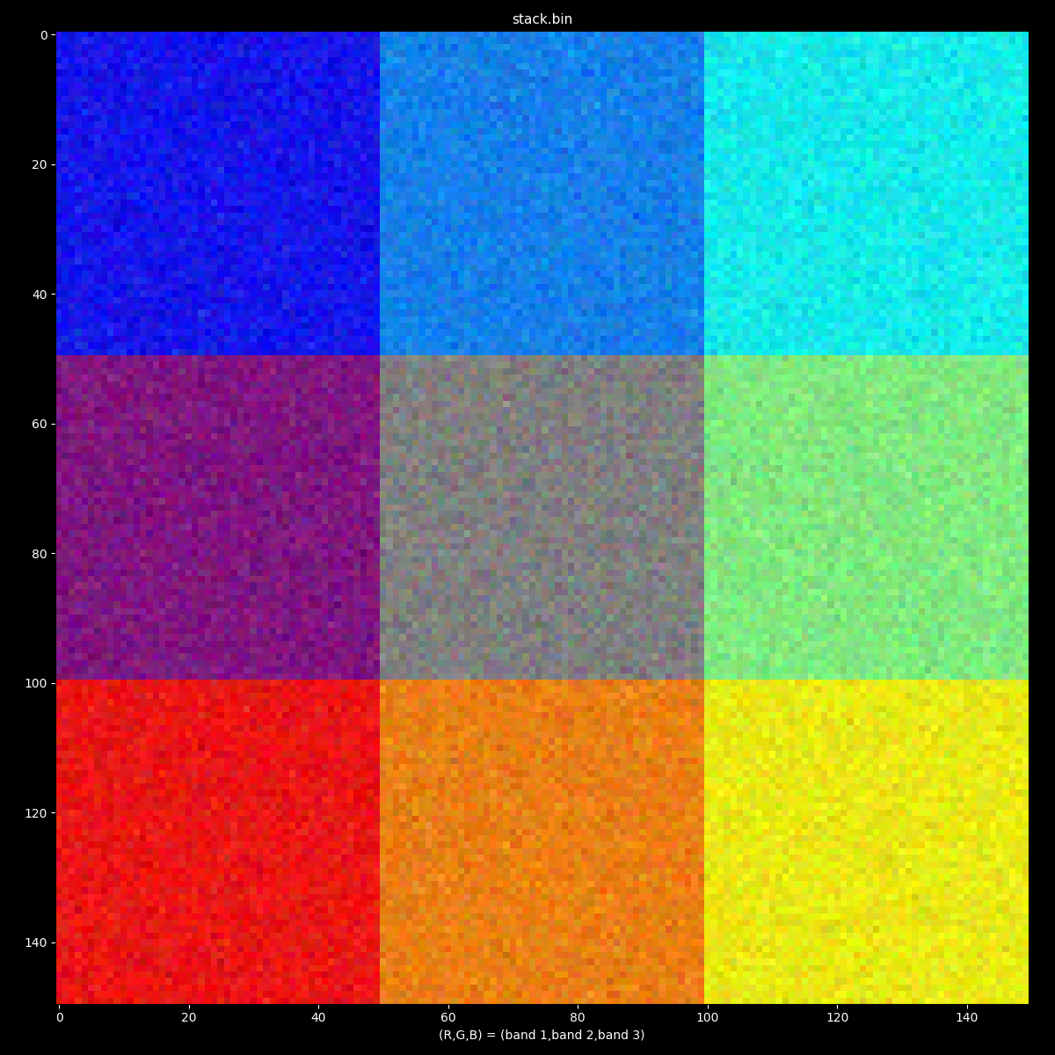
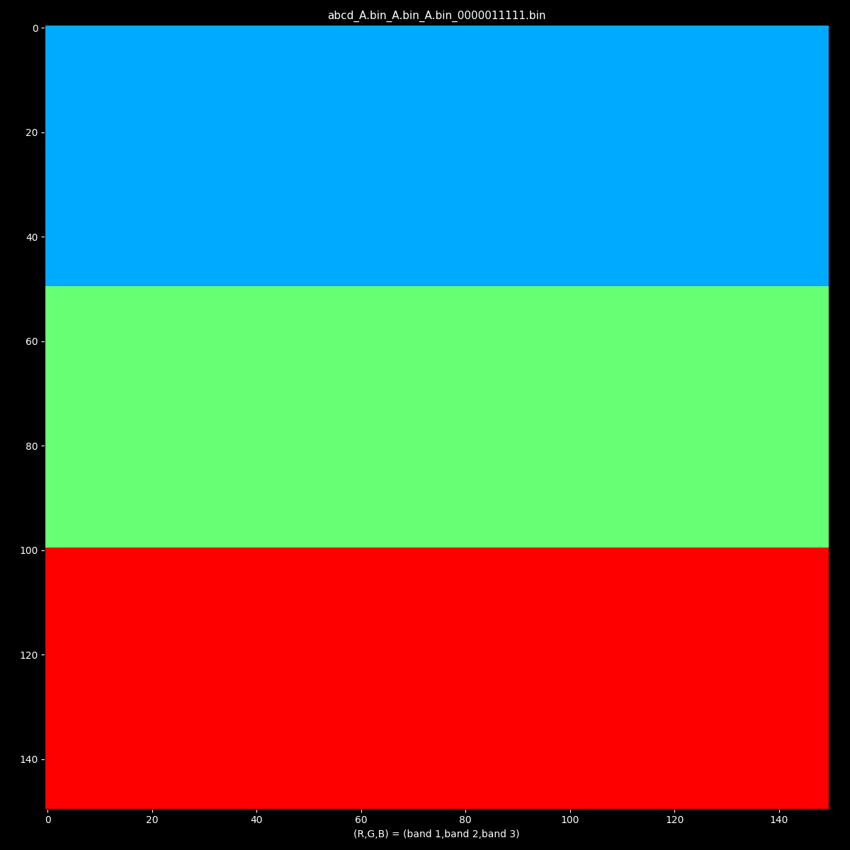
A is to A, as A is to __ ? (A=B=C) --> (D)
A = Synthetic hyperspectral checkerboard with noise

Slide 15
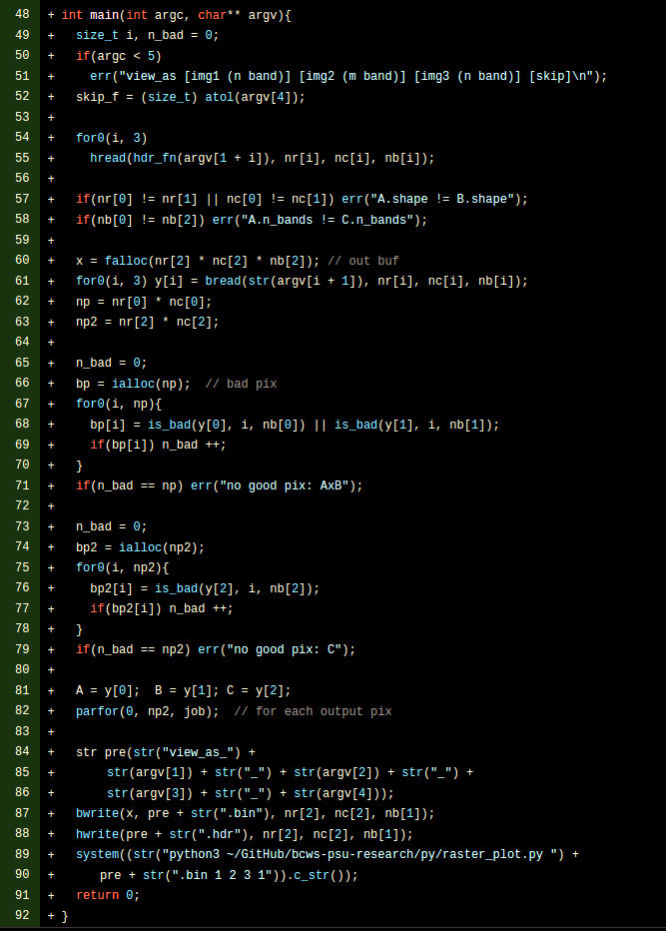
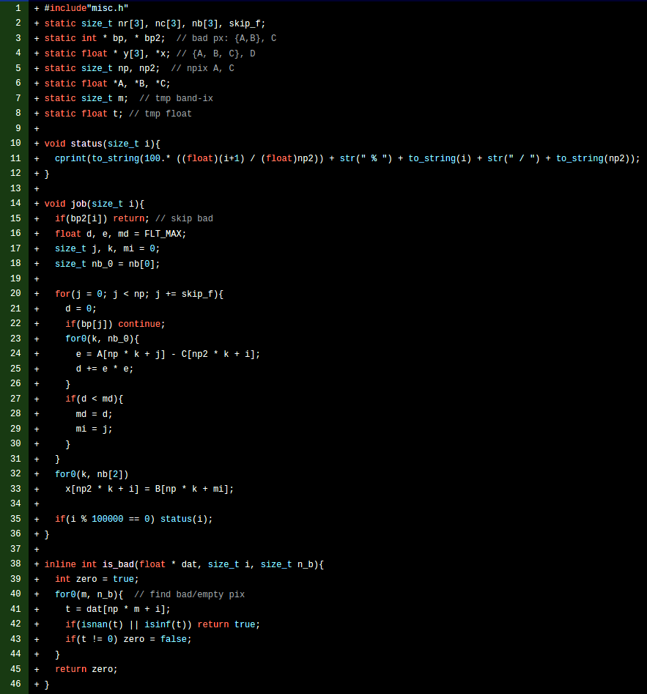
Image translation
https://github.com/bcgov/bcws-psu-research/blob/master/cpp/abcd.cpp
"Tiny AI" challenge
< 100 lines

Slide 16
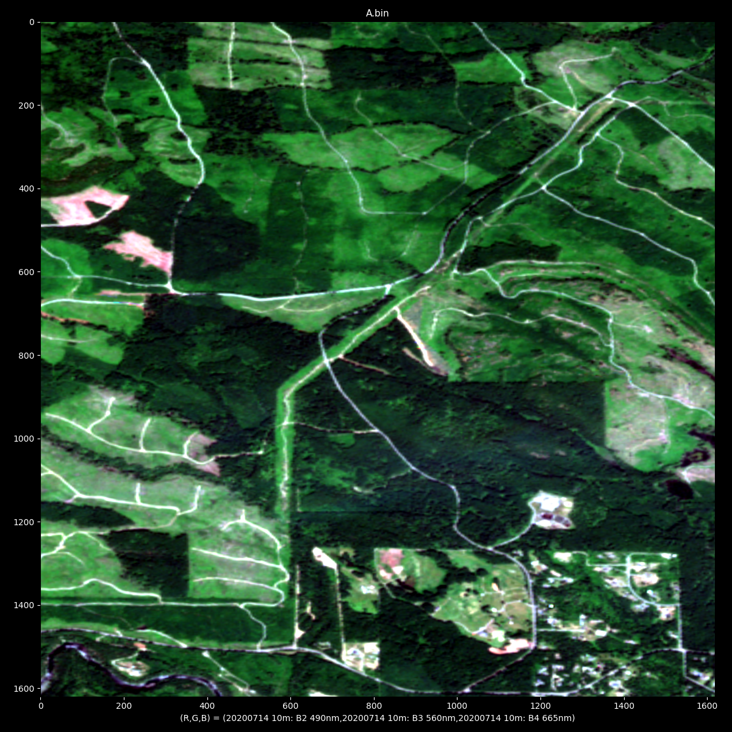
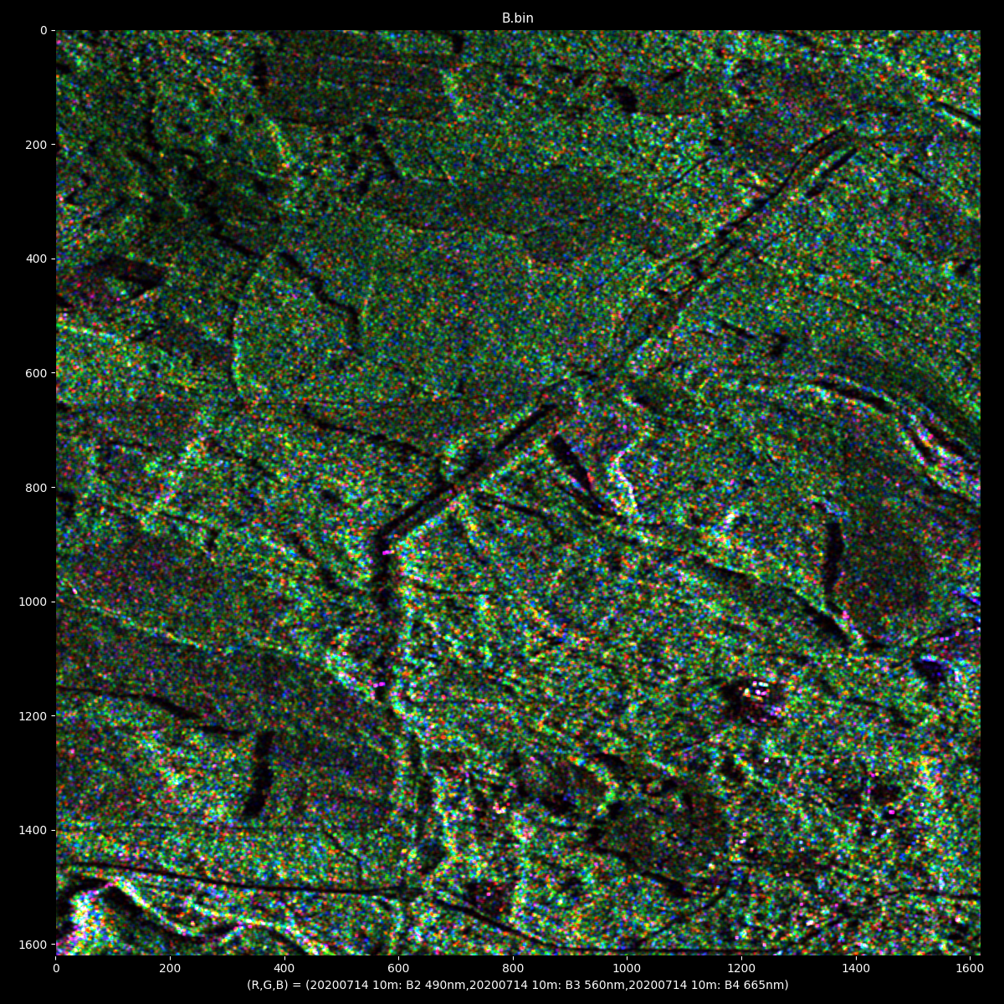
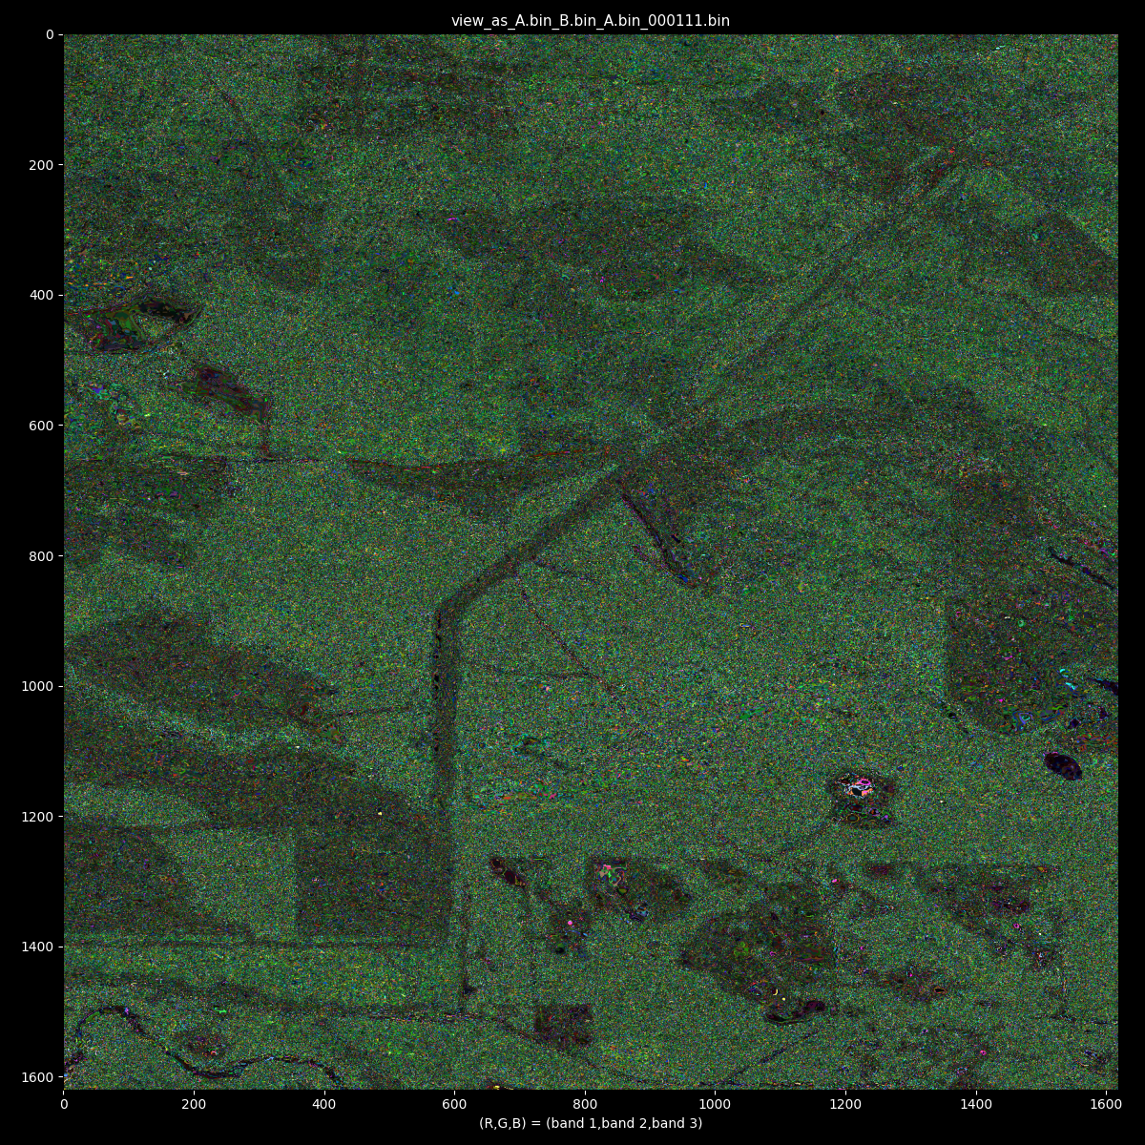
A is to B as A is to D
Would be interesting to include terrain geometry variables and try this again!
Would get better results with higher-dimensional imagery / more bands
Also, bsq2bip -> binary_sort -> bip2bsq method to improve sampling
Simulating RCM from Sentinel-2
Nanaimo BC, 2020
A (Sentinel-2)
B (RCM m-chi)
D

Slide 17
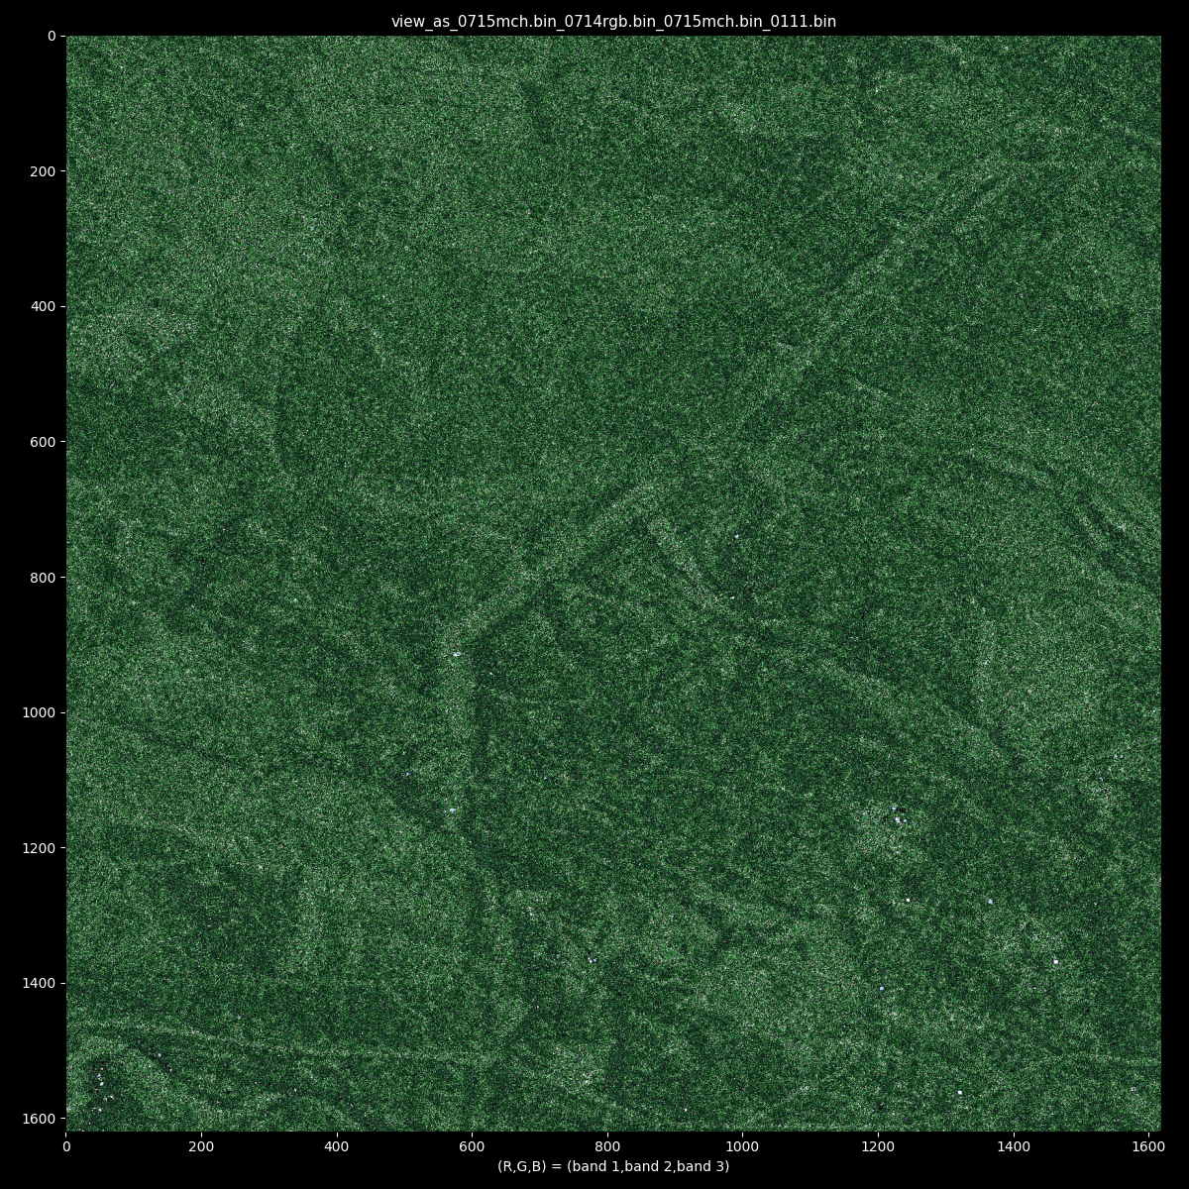
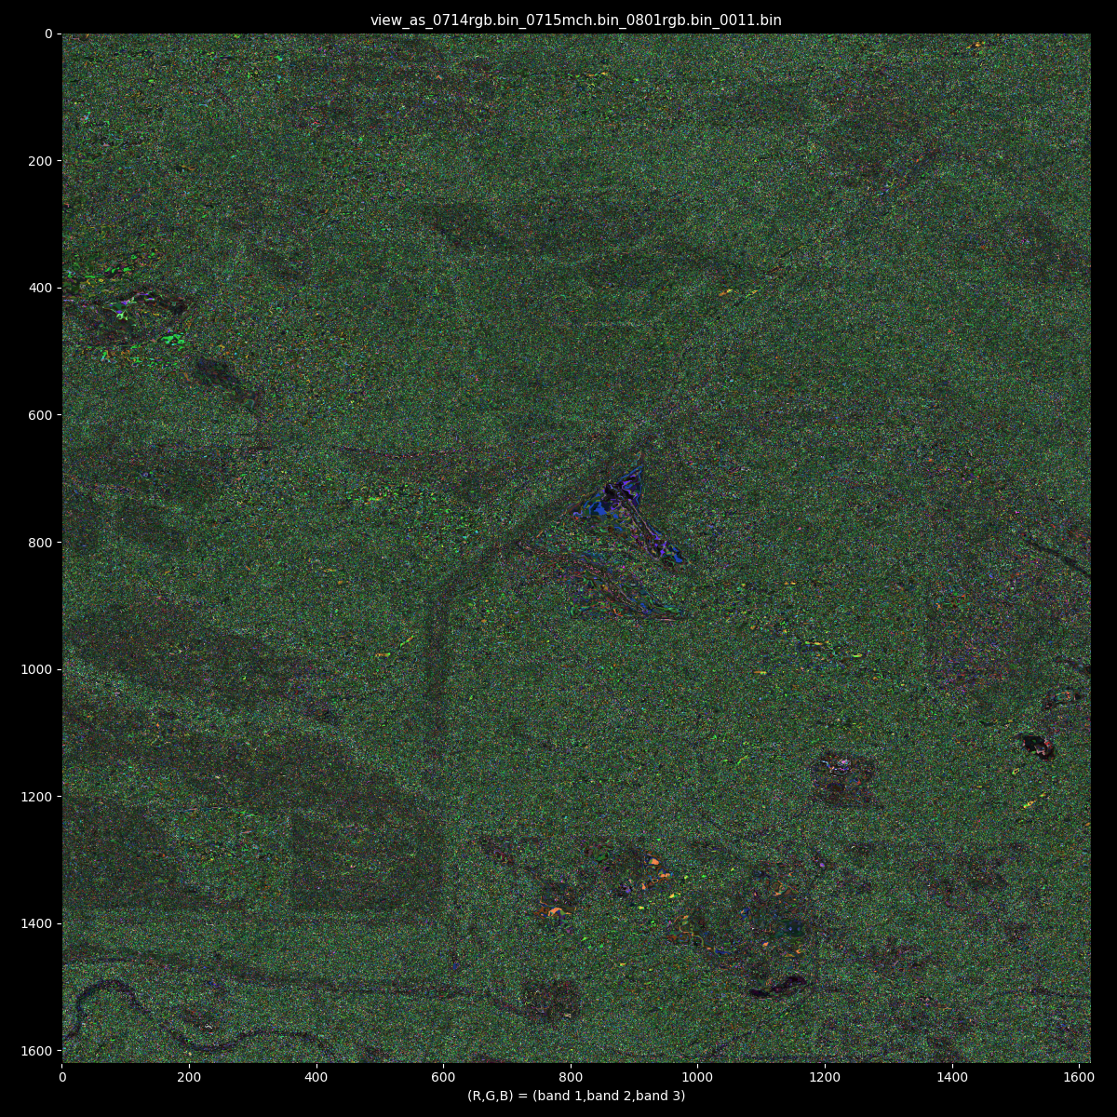
Infer RCM from Sentinel-2 (present, future)
Sentinel-2 predicts
Surface scattering in
clearcut

Slide 18

Predict S2 from RCM
Sentinel-2 seemed more capable in an obvious sense (excepting the obvious.. Clouds)
The forest change is again apparent from RCM
Value in doing more with what we have
abcd_0715mch.bin_0714rgb.bin_0715mch.bin_0111.bin_1_2_3_rgb.png abcd_0715mch.bin_0714rgb.bin_0731mch.bin_0111.bin_1_2_3_rgb.png

Slide 19
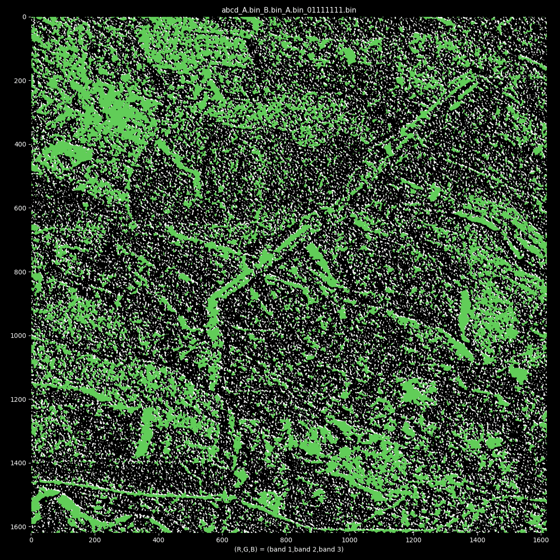
What happens if we "skip" most of the "training" data?
Get an unusual looking result v quickly. Still a pattern hidden in the chaos..
How to outline a noisy blob? Possible solutions:
"Optimal Transport problem" (*)
Clustering algorithms (e.g. KGC-2010 with (i,j) coordinates added to distance function)
Fourier transform?
(*) An efficient numerical algorithm for the L2 optimal transport problem with applications to image processing (Saumier Demers, L.P):
https://dspace.library.uvic.ca/handle/1828/3157
http://ashlinrichardson.com/talks/20210526_character_recognition.pdf
(more continuity of affected area, seen in the difference)

Slide 20
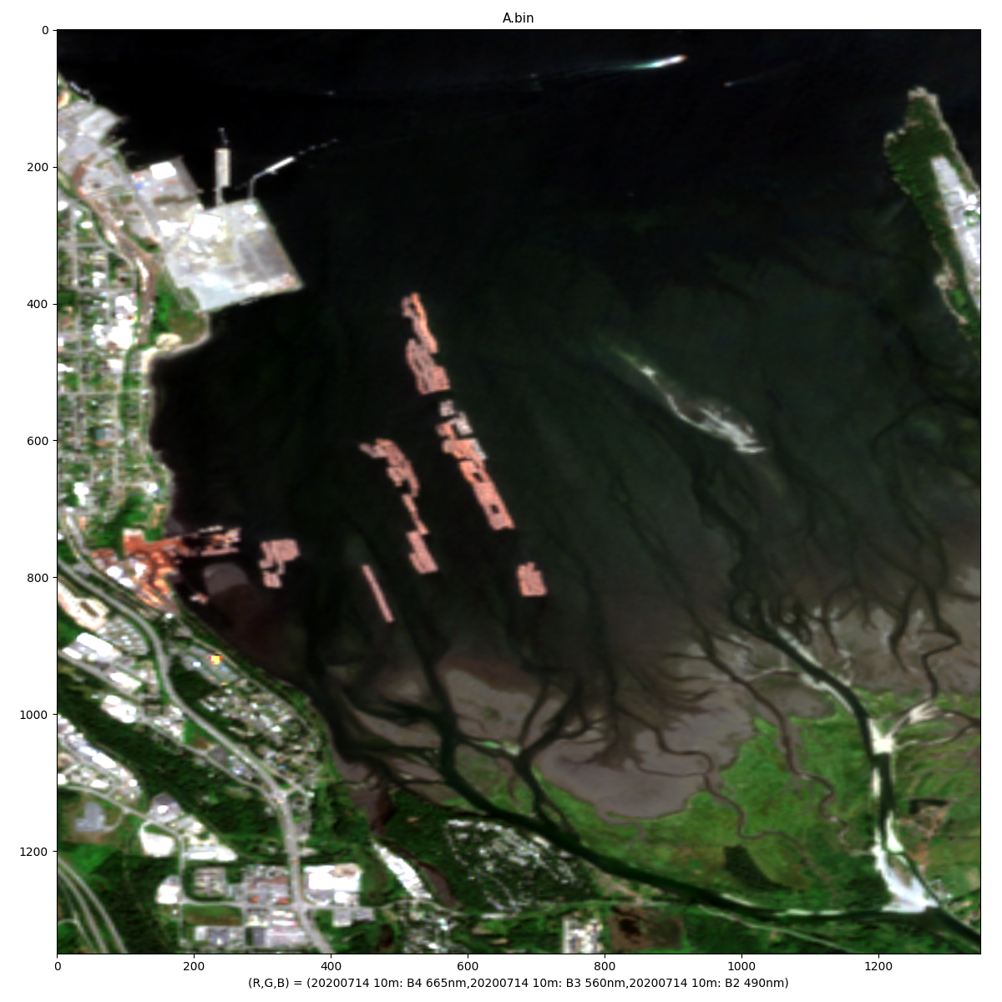
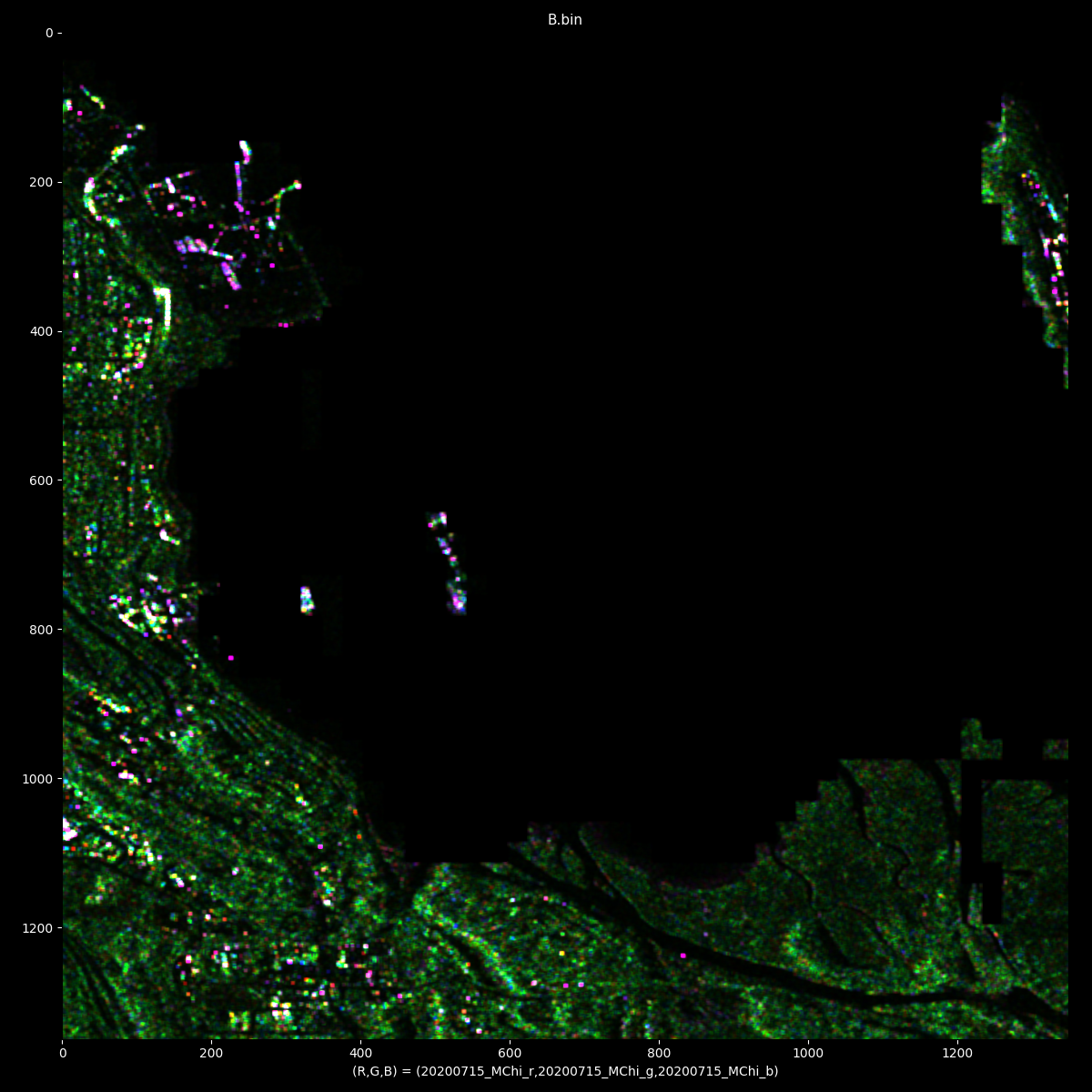
Can we morph RCM into S2?

Slide 21
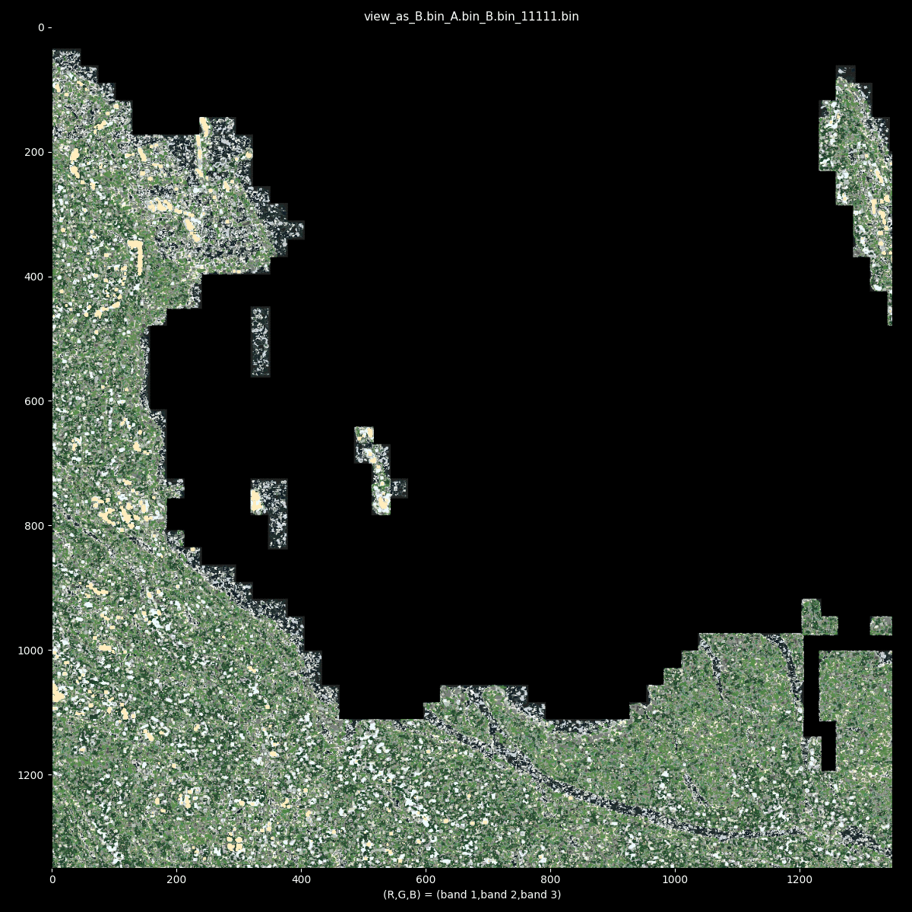

Slide 22
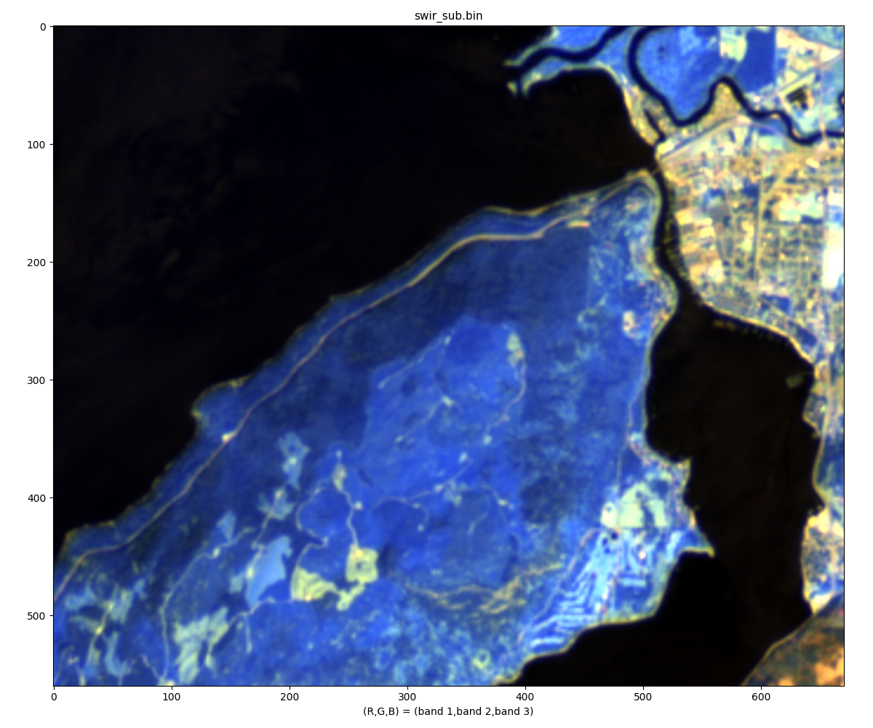
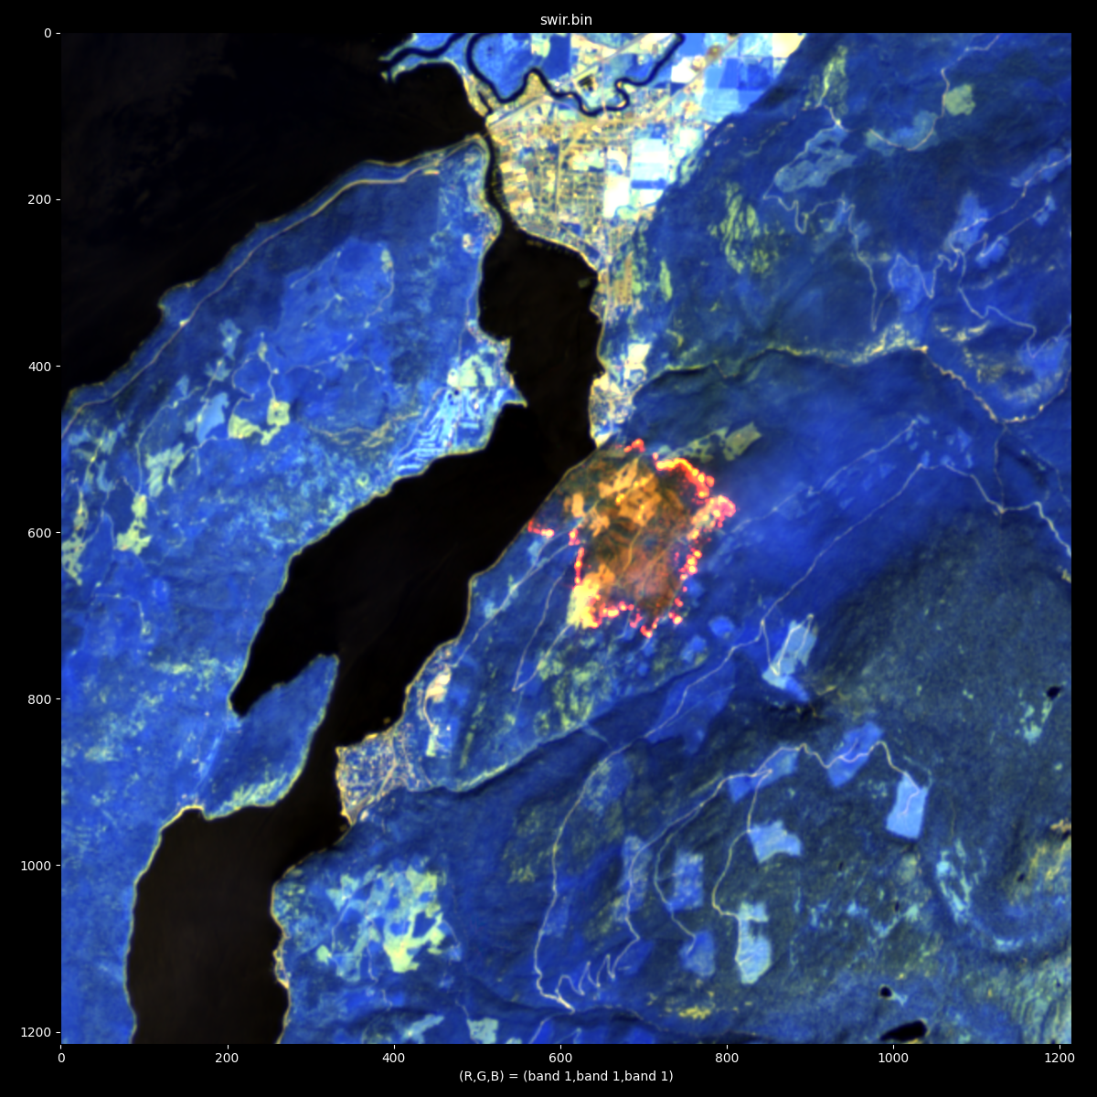
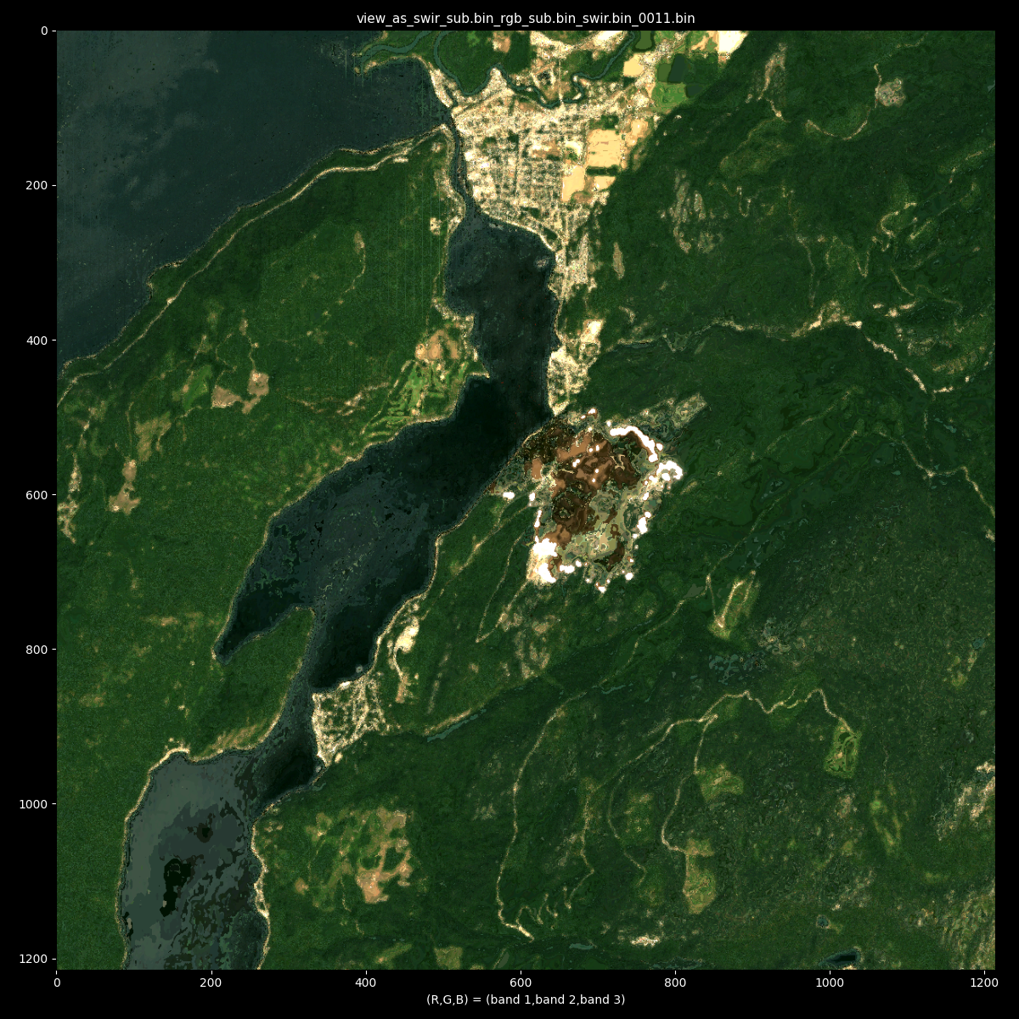
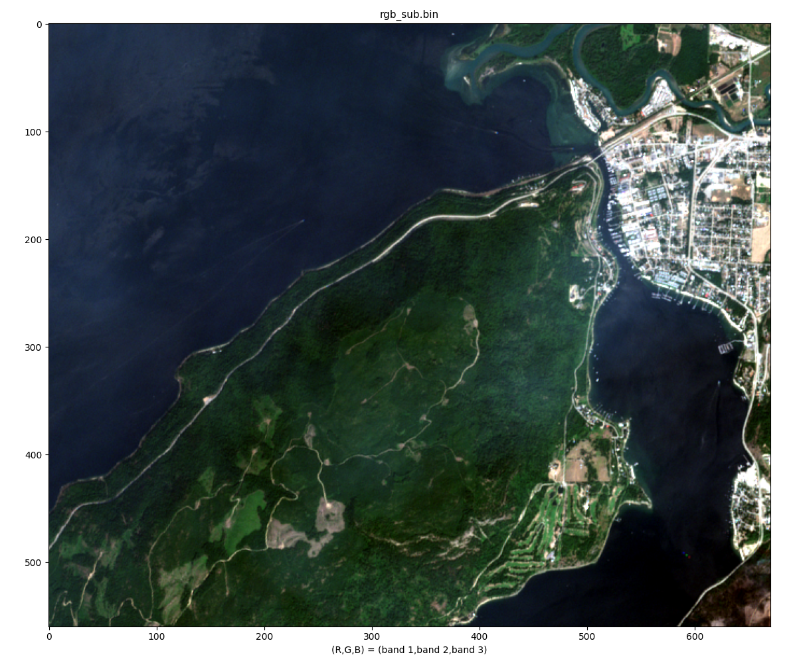
Sicamous BC, 2021. Can we view SWIR in optical?
C) input
D) prediction
A) training
B) training

Slide 23
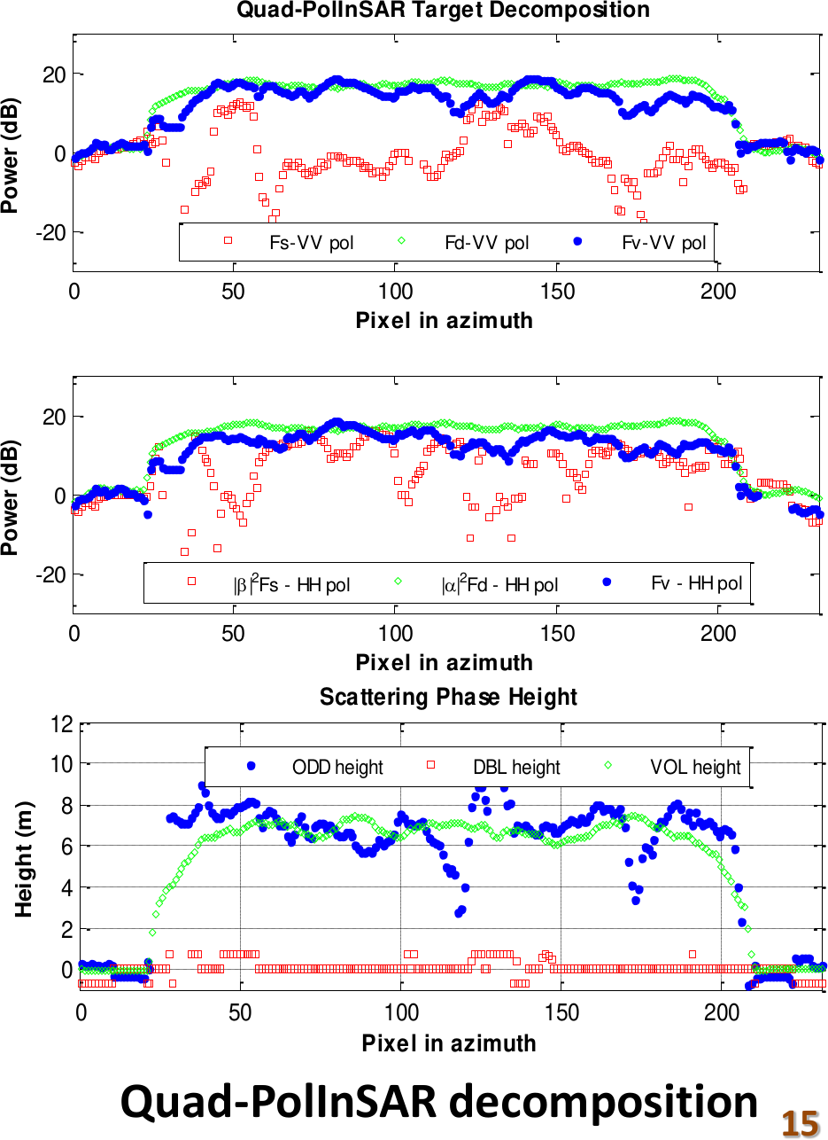
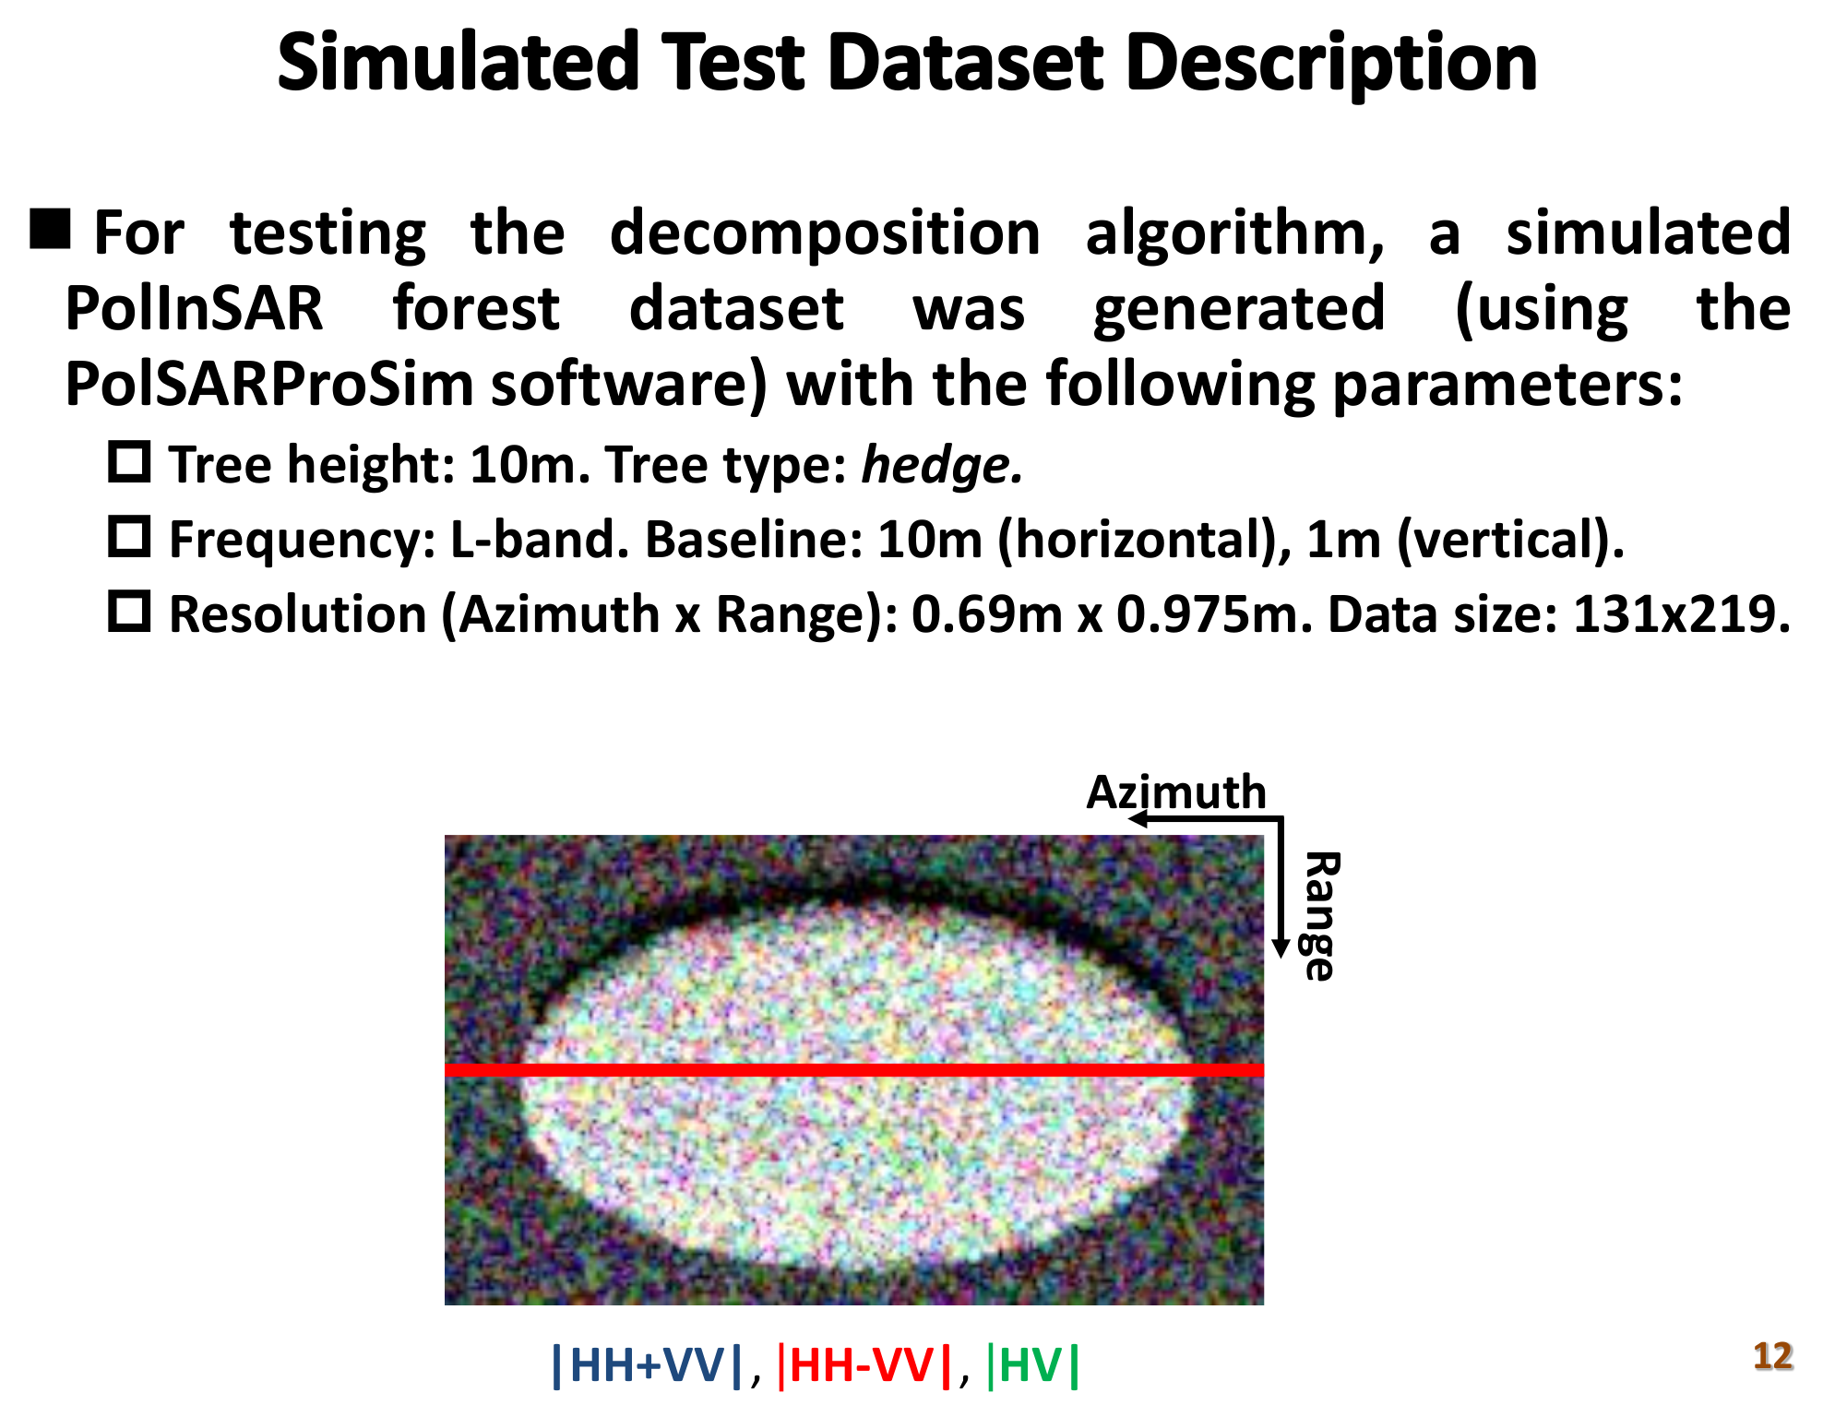
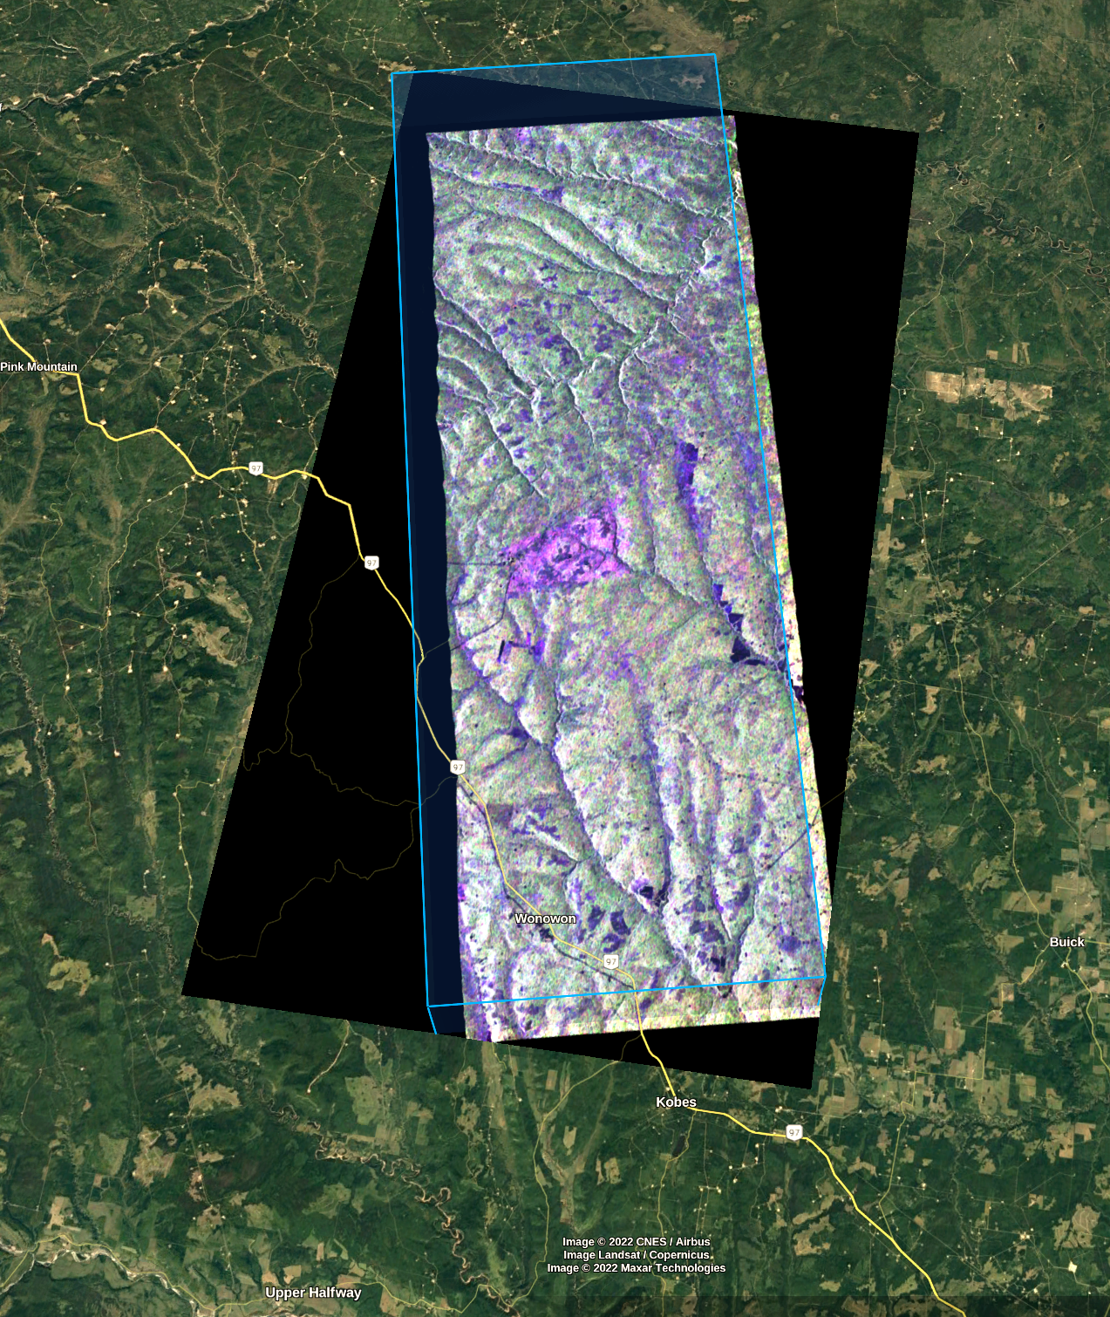
Dimensionality of L-band / Quad-pol
Can delineate harvest / fire events with a single frame (right)
Detect and compensate for ionosphere effects, still model scattering mechanisms
2 or more takes --> inSAR or tomography approach (vertical density of scattering contributions)
Inherently contains 3d info to help correct for topography (Europe/China Dragon cooperation)
Applying the Freeman Durden Decomposition to Compact polarimetric SAR Interferometry, IEEE IGARSS, Québec City, Canada, July 2014

Slide 24








Next steps
More international cooperation will be key!
Continue to develop relationships
Task me? Open to your feedback
Operational-integration engineering (prototype operational products)
Fire mapping (this year)
Fuel type layer challenge (next)
Use ABCD method
as supervised classifier (categorical land cover)
For communication / accessibility
Explanatory visualization to share technical CCD/inSAR/polSAR choicesand trade-offs..
Compare CP vs QP and avail. parameters /decoms
Reconstruction metrics to compare heterogeneous imaging modes
Understand relationships between Prisma, Sentinel2 and RCM data over Sparks Lake Fire
Find synergy with Compact-pol in-SAR decomposition, compact and Quad-pol change detection techniques being advanced by colleagues!
Next reporting: applying to present, (Oct) Wildfire 2022 conference on:
Fuels mapping Ground study (3rd iteration underway)
Fire mapping (currently being examined by dev team)
Fuels mapping province-wide pilot (first iteration)
Background missions
Use trajectory analysis for consistent representation to integrate (disparate) data streams!
Pursue PolSAR, Multi & Hyperspec, LiDAR for fire and inter-related hazards, and ecosystem support

Slide 25
Thanks
CSA for collab & extraordinary data.
Emmanuelle, Daniel, Cédric, Guennadi & team for the inspiring session!
Public Safety Canada for RCM tasking during fire, flood/slide seasons
Analysis in progress (3 sets). Thanks Cameron
BC Wildfire, Brent, Predictive Services Unit, & BC Stats / DSP program
JAXA for accepting BCWS L-band access application. Grateful for the opportunity!
A. Rosenqvist for collab & data feasibility study
H. Chen for cooperation on RCM
ASI for Prisma hyperspectral data
NASA for ARSET training
S. Nasonova & BC Forest Inventory program
A. Bevington & BCGov R.S. CoP
C. Froese for sharing with our CoP
ESA for Sentinel-2 and Dr. Pottier for PolSARPro!
L. Veci & team, and ESA for SNAP software
B Martin for field data collection. M Sakals and J Nicholas for RPAS collection
DLR for initial connection
CFS / NRCAN, TRU, and other partners
D Goodenough, D Bancroft, S Cloude, A Marino, S Dey for consultations!
Thanks for your collaboration any thoughts / feedback / direction you can share!

